Slide 1
Binary Search Trees
<
6
2
>
9
1
4
=
8

Slide 2

Recall: Ordered Maps
Keys come from a total order
New operations:
Each returns an iterator to an entry:
firstEntry(): smallest key in the map
lastEntry(): largest key in the map
floorEntry(k): largest key ≤ k
ceilingEntry(k): smallest key ≥ k
All return end if the map is empty

Slide 3
Binary Search
Binary search can perform operations get, floorEntry and ceilingEntry on an ordered map implemented by means of an array-based sequence, sorted by key
similar to the high-low game
at each step, the number of candidate items is halved
terminates after O(log n) steps
Example: find(7)
0
1
3
4
5
7
8
9
11
14
16
18
19
l
m
h
0
1
3
4
5
7
8
9
11
14
16
18
19
l
m
h
0
1
3
4
5
7
8
9
11
14
16
18
19
l
m
h
0
1
3
4
5
7
8
9
11
14
16
18
19
l=m =h

Slide 4
Search Tables
A search table is an ordered map implemented by means of a sorted sequence
We store the items in an array-based sequence, sorted by key
We use an external comparator for the keys (for any arbitrary comparison)
Performance:
get, floorEntry and ceilingEntry take O(log n) time, using binary search
get takes O(n) time since in the worst case we have to shift n/2 items to make room for the new item
erase take O(n) time since in the worst case we have to shift n/2 items to compact the items after the removal

Slide 5
Binary Search Trees
A binary search tree is a binary tree storing keys (or key-value entries) at its internal nodes and satisfying the following property:
Let u, v, and w be three nodes such that u is in the left subtree of v and w is in the right subtree of v. We have key(u) ≤ key(v) ≤ key(w)
External nodes do not store items
An inorder traversal of a binary search trees visits the keys in increasing order
6
2
9
1
4
8

Slide 6
Search
To search for a key k, we trace a downward path starting at the root
The next node visited depends on the comparison of k with the key of the current node
If we reach a leaf, the key is not found
Example: get(4):
Call TreeSearch(4,root)
The algorithms for floorEntry and ceilingEntry are similar
Recursive
Algorithm TreeSearch(k, v)
if v.isExternal ()
return v
if k < v.key()
return TreeSearch(k, v.left())
else if k = v.key()
return v
else { k > v.key() }
return TreeSearch(k, v.right())
<
6
2
>
9
1
4
=
8

Slide 7
Insertion
Example: insert(5)
To perform operation put(k, o), we search for key k (using TreeSearch)
Assume k is not already in the tree, and let w be the leaf reached by the search
We insert k at node w and expand w into an internal node
<
6
2
>
9
1
4
>
8
w
6
2
9
1
4
8
w
5

Slide 8
Deletion
To perform operation erase(k), we search for key k
Assume key k is in the tree, and let v be the node storing k
Basic method
removeAboveExternal(w): removes w and its parent
If node v has a leaf child w, we remove v and w from the tree with removeAboveExternal(w)
What about “remove 1”?
Example: remove 4
<
6
2
>
9
1
4
v
8
w
5
6
2
9
1
5
8

Slide 9
Deletion (cont.)
Example: remove 3
Key k to be removed is stored at a node v whose children are both internal
1. Find the internal node w that follows v in an inorder traversal (find the smallest w larger than v)
2. Copy key(w) into node v
3. Remove node w and its left child z (which must be a leaf) by means of operation removeExternal(z)
Why left child z?
No other cases?
1
v
3
2
8
6
9
w
5
z
1
v
5
2
8
6
9

Slide 10
Performance
Consider an ordered map with n items implemented by a binary search tree of height h
Space: O(n)
methods get, floorEntry, ceilingEntry, put and erase take O(h) time
The height h is O(n) in the worst case and O(log n) in the best case
Question: Can we find the algorithm with worst-case O(log n)
Idea??? Balancing

Slide 11
AVL Trees
6
v
3
8
z
4
Adelson-Velskii, G.; E. M. Landis (1962). “"An algorithm for the organization of information"”. Proceedings of the USSR Academy of Sciences 146: 263–266. (Russian) English translation by Myron J. Ricci in Soviet Math. Doklady, 3:1259–1263, 1962.

Slide 12
AVL Tree Definition
An AVL Tree T is a binary search tree with the following property
Height-Balance: For every internal node v of T, the heights of the children of v can differ by at most 1
This tree seems to be well-balanced
Height: O(log n)

Slide 13
Height of an AVL Tree (1)
Fact: The height of an AVL tree storing n keys is O(log n).
Proof
n(h): the minimum number of internal nodes of an AVL tree of height h.
Easily see that n(1) = 1 and n(2) = 2
For h > 2, an AVL tree of height h and the minimum number of nodes contains (i) the root node, (ii) one AVL subtree of height h-1 and (iii) another AVL subtree of height h-2.
That is, n(h) = 1 + n(h-1) + n(h-2)
Knowing n(h-1) > n(h-2), we get n(h) > 2n(h-2). So
n(h) > 2n(h-2), n(h) > 4n(h-4), n(h) > 8n(n-6), … (by induction),
n(h) > 2^{i}n(h-2i)
n(2)
3
4
n(1)
Notes:
N key로 height의 upperbound를 구하기 때문에, 최소의 숫자로 달성할 수 있는 tree의 height에 관심이 있다.

Slide 14
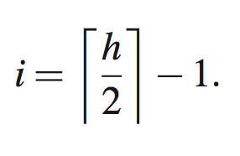
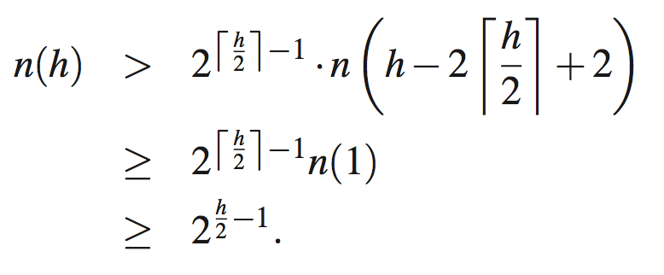
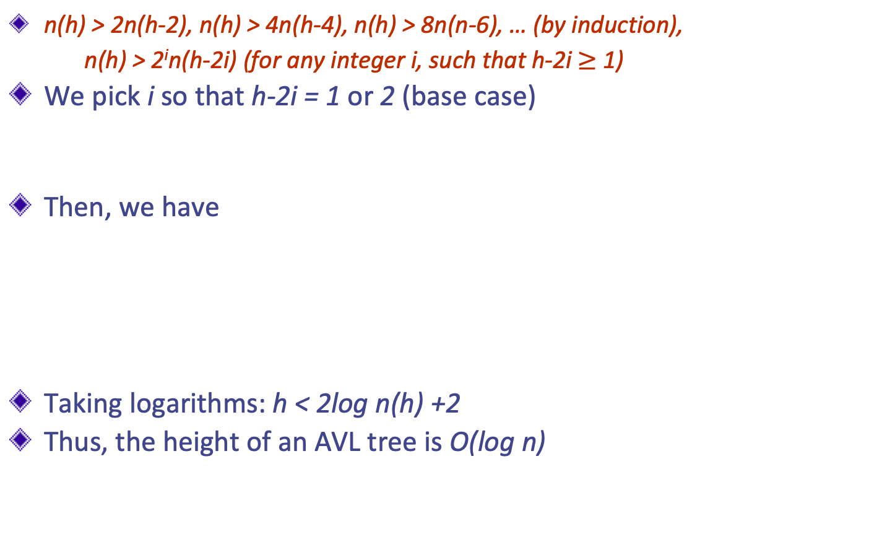
Height of an AVL Tree (2)
n(h) > 2n(h-2), n(h) > 4n(h-4), n(h) > 8n(n-6), … (by induction),
n(h) > 2^{i}n(h-2i) (for any integer i, such that h-2i $≥$ 1)
We pick i so that h-2i = 1 or 2 (base case)
Then, we have
Taking logarithms: h < 2log n(h) +2
Thus, the height of an AVL tree is O(log n)
n(2)
3
4
n(1)
Notes:
이 과정이 magical할 수 있다. 점화식에서 일반식을 뽑아 내는 것은 애들이 많이 해봤는데, 그것과 비슷한 것이라는 것을 알려주자.

Slide 15
Insertion
Insertion is as in a binary search tree
Always done by expanding an external node.
Example of insertion 54. What’s the problem?
44
44
17
78
17
78
32
50
88
32
50
88
48
62
48
62
54
before insertion 54
after insertion 54

Slide 16
Rebalancing Needed
How should we do this?
(1) Take some examples
(2) Find difference cases
(3) Make each sub-algorithm for each case
(4) Make an entire algorithm
(5) Run it with some inputs
(6) Find out it is not working perfectly, and say “What the hell is this?” “How should I do?”
Lessons
Let’s summarize them later

Slide 17
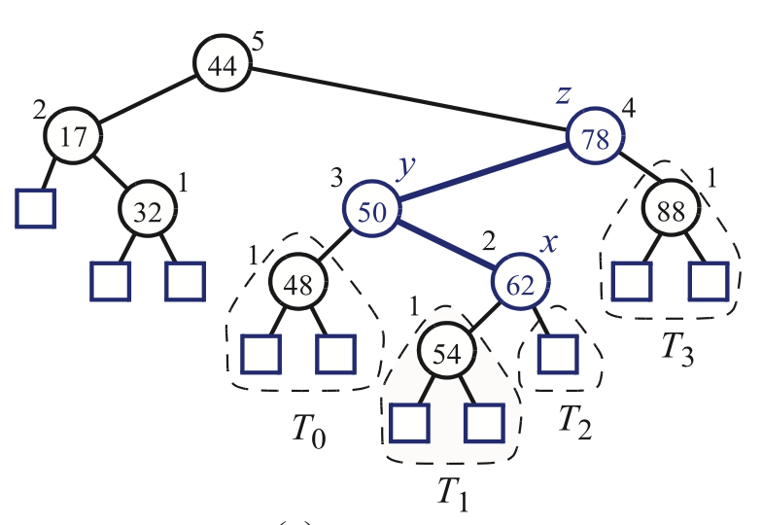
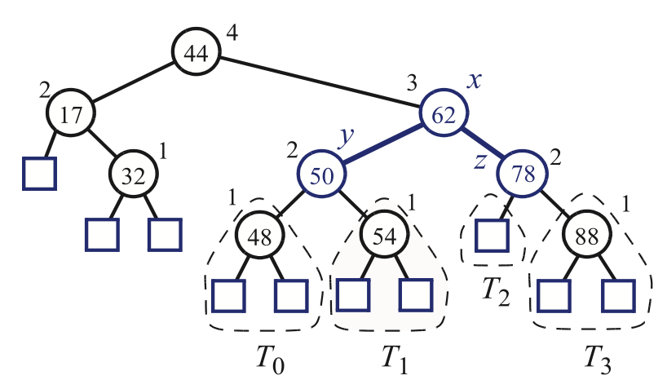
Rebalancing Example: Insertion of w=54
unbalanced
“Search-and-Repair” strategy
z: first node we encounter in going up from w toward the root such that z is unbalanced
y: the child of z with higher height (note that y must be an ancestor of w)
x: the child of y with higher height (there cannot be a tie and node x must be an ancestor of w)
What are we doing for balancing?
Can we do this systematically?
What are other cases?
balanced

Slide 18
Please remember the notations! z, y, z
z: first node we encounter in going up from w toward the root such that z is unbalanced
“w에서 위로 쭉 올라가서, balance깨지는 첫 놈”
y: the child of z with higher height
“그 놈의 자녀 중 키가 큰 놈”
x: the child of y with higher height
“그 키 큰 자녀의 자녀(손주) 중 키가 큰 놈”
Rename x,y,z as a,b,c so that a precedes b and b precedes c in “inorder traversal”
We can make many combinations

Slide 19
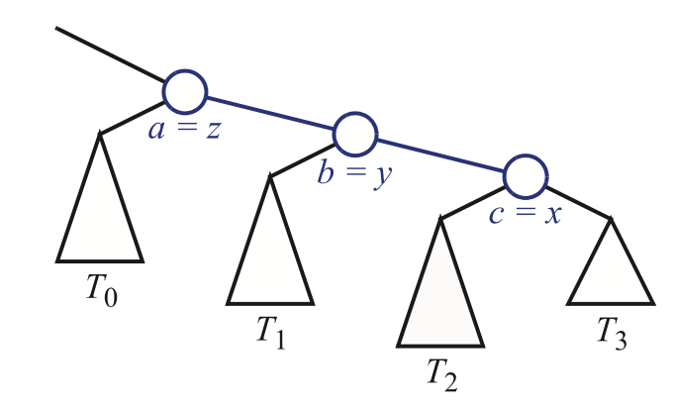
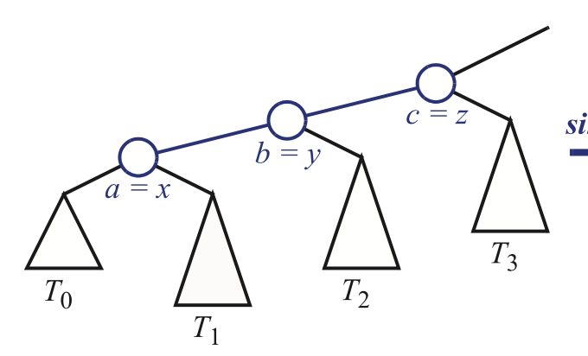
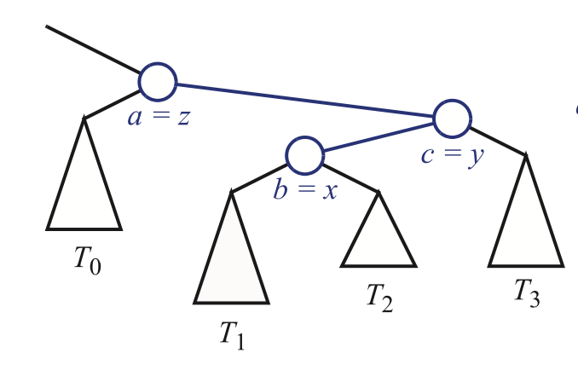
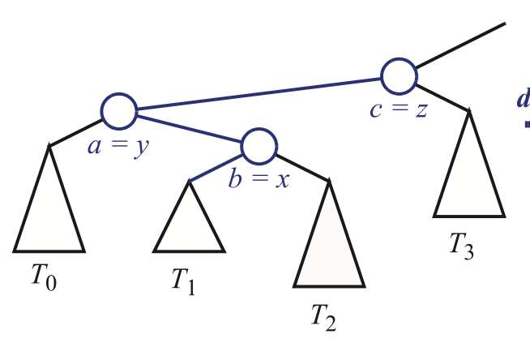
4 Combinations
inorder: z,y,x
inorder: x,y,z
inorder: z,x,y
inorder: y,x,z

Slide 20
Restructuring (as Single Rotations)
Single Rotations:
Left rotation about z
Right rotation about z

Slide 21
Restructuring (as Double Rotations)
double rotations:
Right rotation about y
and left rotation about z
Left rotation about y
and right rotation about z

Slide 22
Removal
Removal begins as in a binary search tree, which means the node removed (after copying the in-order successor) will become an empty external node. Its parent, w, may cause an imbalance.
Example:
44
44
17
62
17
62
32
50
78
50
78
48
54
88
48
54
88
before deletion of 32
after deletion

Slide 23
Rebalancing after a Removal
Let z be the first unbalanced node encountered while travelling up the tree from w. Also, let y be the child of z with the larger height, and let x be the child of y with the larger height
We perform restructure(x) to restore balance at z
What happens if z is an internal node, not the root?
As this restructuring may upset the balance of another node higher in the tree, we must continue checking for balance until the root of T is reached
a=z
62
44
w
b=y
44
78
17
62
c=x
17
50
88
50
78
48
54
48
54
88

Slide 24
AVL Tree Performance
a single restructure takes O(1) time
using a linked-structure binary tree
find takes O(log n) time
height of tree is O(log n), no restructures needed
put takes O(log n) time
initial find is O(log n)
Restructuring up the tree, maintaining heights is O(log n)
erase takes O(log n) time
initial find is O(log n)
Restructuring up the tree, maintaining heights is O(log n)

Slide 25
Recall: Rebalancing Needed
How should we do this?
(1) Take some examples
(2) Find difference cases
(3) Make each sub-algorithm for each case
(4) Make an entire algorithm
(5) Run it with some inputs
(6) Find out it is not working perfectly, and say “What the hell is this?” “How should I do?”
Lessons
Sometimes, we need to do case-by-case handling to complete the algorithm
People often rely on ”Half-assed (대충) algorithm design first “ and “Complete it using example inputs”. Not recommended.
Same as “Roughly make the code, and debug it later”. Bad coding behavior

